Slide 1









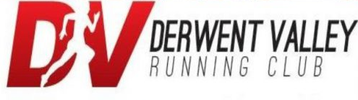















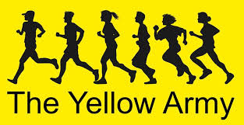














Slide 2
THE BIG ENGLAND
ATHLETICS QUIZ
EXTRAVAGANZA

Slide 3
Round 1:
Comparisons

Slide 4
1.
What is taller?
The Eiffel Tower
or
The Chrysler Building

Slide 5
2.
What is Longer?
The average distance a kangaroo can jump or
The average length of a T-rex

Slide 6
3.
What is heavier?
The international space station (weight on earth)
Or
The Statue of Liberty

Slide 7
4.
What is the shortest?
The distance from the sun to Neptune
Or
The circumference of the Earths orbit around the sun

Slide 8
5.
Which is faster?
The top speed of a giraffe
Or
The top speed of a great white shark

Slide 9
6.
What are there more of?
People in Austria (population)
Or
Number of articles on Wikipedia

Slide 10
7.
Which is shorter?
The height of the Leaning Tower of Pisa
Or
The height of Big Ben

Slide 11
8.
Which of these is deeper?
The deepest part of the ocean (Mariana trench)
Or
The deepest mine in the world (Mponeng gold mine)

Slide 12
9.
Which has the smallest population?
Jamaica
Or
Luxembourg

Slide 13
10.
Which is further?
The distance from London to New York
Or
The length of the river Nile

Slide 14
Round 2:
PICTURE ROUND
Celebrity merged faces

Slide 15
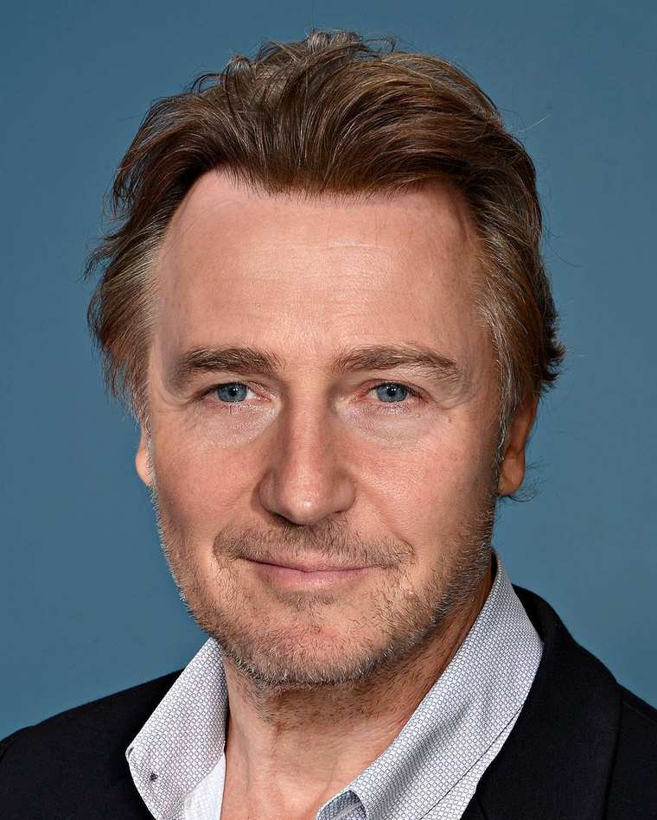
1.

Slide 16
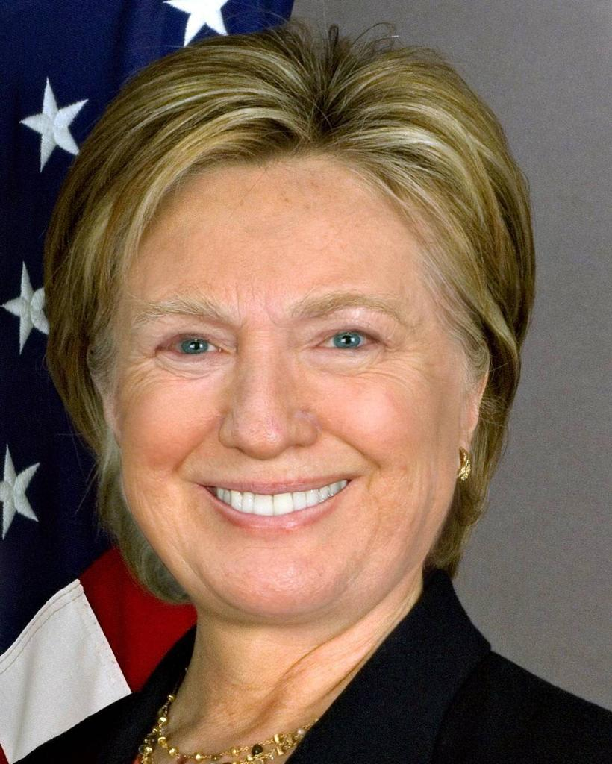
2.

Slide 17
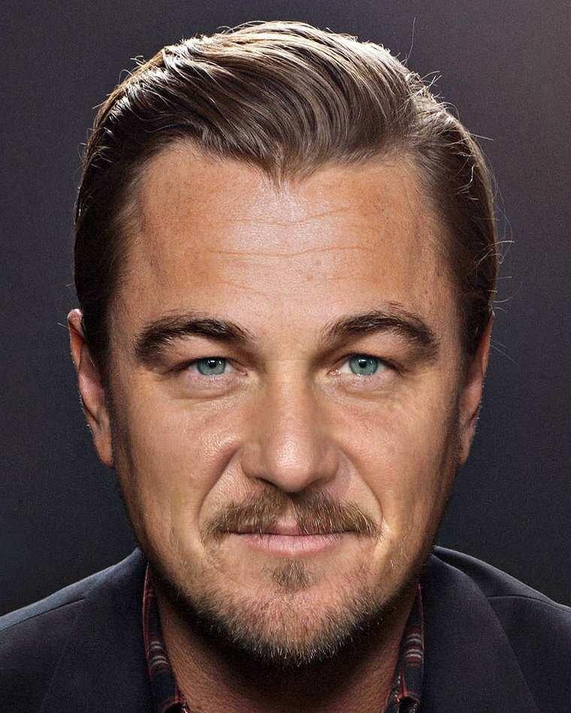
3.

Slide 18
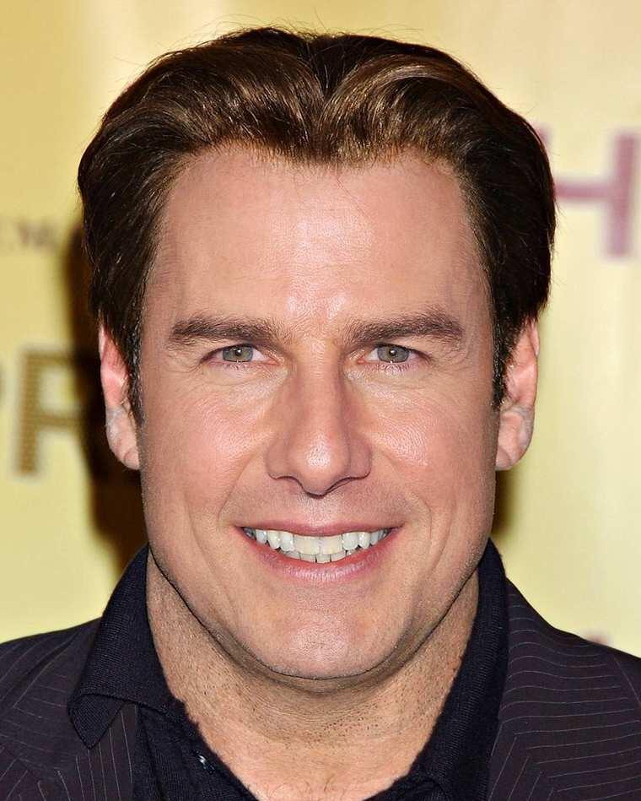
4.

Slide 19
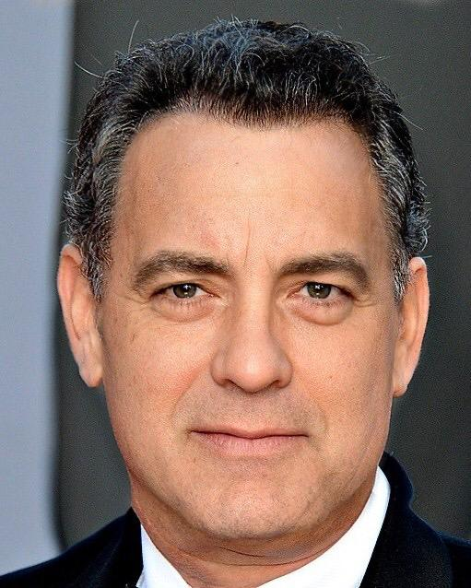
5.

Slide 20
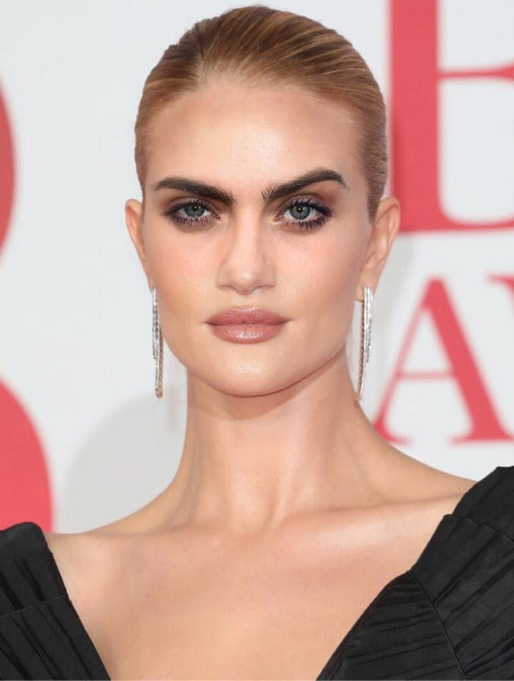
6.

Slide 21
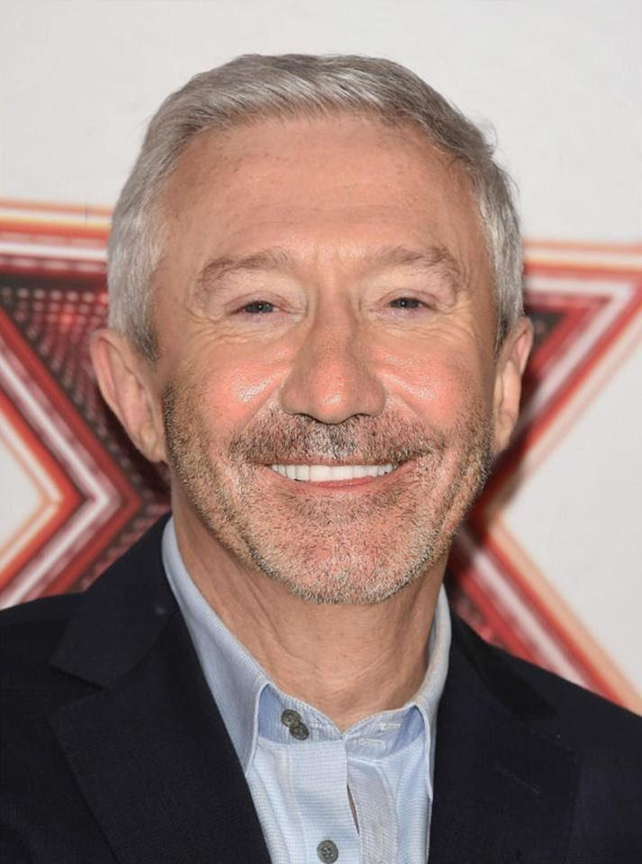
7.

Slide 22
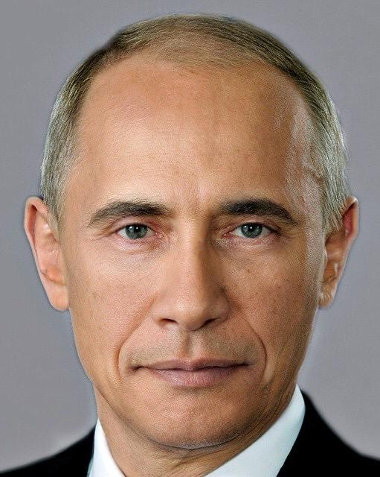
8.
"HERE'S JOHNNY!”

Slide 23
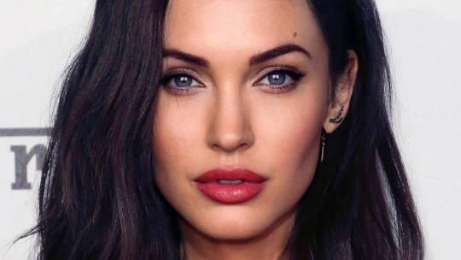
9.

Slide 24
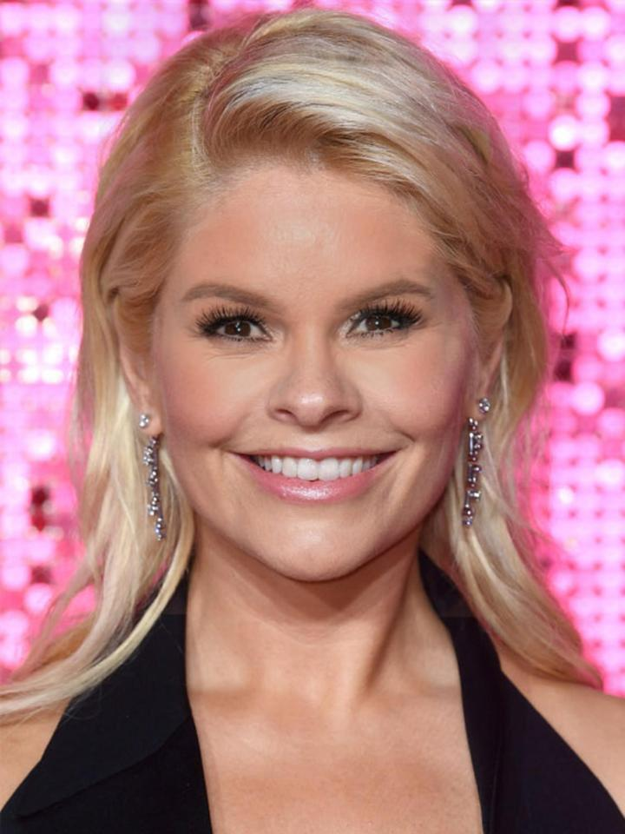
10.

Slide 25
Round 3:
Athletics Trivia

Slide 26
1.
This week, who thought he had broken Usain Bolts 200m world record?

Slide 27
2.
Why was the record dismissed?

Slide 28
3.
What distance was the first Olympic race held in 776BC?

Slide 29
4.
How many countries compete in major athletics Championships?
153
183
203

Slide 30
5.
Sergei Bubka the famous pole vaulter, set more athletics world records than anyone else during his career.
How many did he set?

Slide 31
6.
How wide is a standard high jump bar?

Slide 32
7.
What long distance running event takes place in the Sahara Desert in southern Morocco?

Slide 33
8.
Who was disqualified following a false start in the 100m final at the Daegu world championships in 2011?

Slide 34
9.
Which famous GB sprinter was helped over the line by his dad in the 1992 Olympic games in Barcelona?

Slide 35
10.
How many athletes competed in athletics events at the 2012 Olympic games?
1067
2231
2853

Slide 36
ANSWERS
Round 1:
Comparisons

Slide 37
1.
What is taller?
The Eiffel Tower
Or
The Chrysler Building
Eiffel tower 324m
Chrysler Building 319m

Slide 38
2.
What is Longer?
The average distance a kangaroo can jump
or
The average length of a T-rex
Kangaroo jumps 13.5m
T-rex 12.3m

Slide 39
3.
What is heavier?
The international space station (weight on earth)
Or
The Statue of Liberty
ISS 420000kg
SoL 201200kg

Slide 40
4.
What is the shortest?
The distance from the sun to Neptune
Or
The circumference of the Earths orbit around the sun
Earths orbit 940mkm
Sun to Neptune 4.5bnkm

Slide 41
5.
Which is faster?
The top speed of a giraffe
Or
The top speed of a great white shark
Giraffe 52kph
Shark 20kph

Slide 42
6.
What are there more of?
People in Austria (population)
Or
Number of articles on Wikipedia
Austria 8.75m
Wiki 5.66m

Slide 43
7.
Which is shorter?
The height of the Leaning Tower of Pisa
Or
The height of Big Ben
Pisa 57m
Big Ben 96m

Slide 44
8.
Which of these is deeper?
The deepest part of the ocean (Mariana trench)
Or
The deepest mine in the world (Mponeng gold mine)
Mariana 10.99km
Mine 3.9km

Slide 45
9.
Which has the smallest population?
Jamaica
Or
Luxembourg
Luxembourg 594100
Jamaica 2.78 m

Slide 46
10.
Which is further?
The distance from London to New York
Or
The length of the river Nile
Nile 6850km
LHR – JFK 5580km

Slide 47
Round 2:
PICTURE ROUND
Celebrity merged faces

Slide 48
1.
Liam Neeson
Edward Norton

Slide 49
2.
Donald Trump
Hilary Clinton

Slide 50
3.
Leonardo Dicaprio
Sean Penn

Slide 51
4.
Tom Cruise
John Travolta

Slide 52
5.
Tom Hanks
George
Clooney

Slide 53
6.
Rosie Huntington-Whiteley
Cara Delevigne

Slide 54
7.
Louis Walsh
Simon Cowell

Slide 55
8.
"HERE'S JOHNNY!”
Vladimir Putin
Barack Obama

Slide 56
9.
Angelina Jolie
Megan Fox

Slide 57
10.
Holly Wiloughby
Amanda Holden

Slide 58
ANSWERS
Round 3:
Athletics Trivia

Slide 59
1.
This week, who thought he had broken Usain Bolts 200m world record?
Noah Lyles

Slide 60
2.
Why was the record dismissed?
They only ran 185m

Slide 61
3.
What distance was the first Olympic race held in 776BC?
600m

Slide 62
4.
How many countries compete in major athletics Champion ships?
153
183
203

Slide 63
5.
Sergei Bubka the famous pole vaulter, set more athletics world records than anyone else during his career.
How many did he set?
35

Slide 64
6.
How wide is a standard high jump bar?
4m

Slide 65
7.
What long distance running event takes place in the Sahara desert in southern Morocco?
Marathon des Sables

Slide 66
8.
Who was disqualified following a false start in the 100m final at the Daegu world championships in 2011?
Usain Bolt

Slide 67
9.
Which famous GB sprinter was helped over the line by his dad in the 1992 Olympic games in Barcelona?
Derek Redmond

Slide 68
10.
How many athletes competed in athletics events at the 2012 Olympic games?
1067
2231
2853

Slide 69
The End
Let us know your scores

