Slide 1









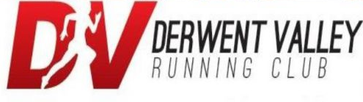















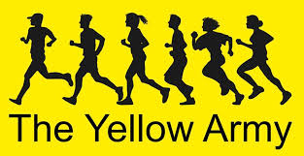














Slide 2
THE BIG ENGLAND
ATHLETICS QUIZ
EXTRAVAGANZA

Slide 3
Round 1:
Flags

Slide 4
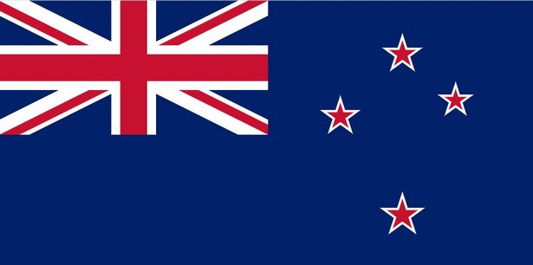
1.
Whose flag is this?

Slide 5
2.
What three colours make up the Italian flag?

Slide 6
3.
Who famously wore the cross now used on the English flag?

Slide 7
4.
How many stars appear on the flag of Europe?

Slide 8
5.
Which way does the dragon face on the Welsh flag?
Right or Left

Slide 9
6.
What do the flags of Albania, Kazakhstan and Sri Lanka all contain?
Animals
Writing
The colour green

Slide 10
7.
What is the fastest time for identifying every national flag?
4.51 minutes
6.13 minutes
7.26 minutes

Slide 11

8.
Which country did this flag used to represent?
Portugal
France
The Netherlands

Slide 12
9.
Which flag is flown when the queen is in residence at Buckingham Palace?

Slide 13


10.
At the London 2012 Olympics these two flags were mixed up by event organisers?
Who do they belong to?

Slide 14
Round 2:
Who said it?

Slide 15
1.
"Never let the fear of striking out keep you from playing the game."

Slide 16
2.
"You have brains in your head. You have feet in your shoes. You can steer yourself any direction you choose."

Slide 17
3.
"The way to get started is to quit talking and begin doing."

Slide 18
4.
“Insanity, is doing the same thing over again and expecting different results”

Slide 19
5.
“No, I am your father”

Slide 20
6.
“Be the change that you wish to see in the world.”

Slide 21
7.
“Volunteering is for suckers, did you know that volunteers don’t even get paid for the stuff they do?”

Slide 22
8.
“My mama always said life was like a box of chocolates”

Slide 23
9.
"It's really cold outside, they are calling it a major freeze, weeks ahead of normal. Man, we could use a big fat dose of global warming!"

Slide 24
10.
“Hasta la vista, baby.”

Slide 25
Round 3:
Athletics Trivia

Slide 26
1.
What is the weight of a standard men's discus?

Slide 27
2.
How old was Usain Bolt when he originally broke the 100m world record?

Slide 28
3.
Which female middle distance runner, famously competed bare foot?

Slide 29
4.
In the decathlon, which event comes first?

Slide 30
5.
At the London 2012 Olympics 3 athletics world records were broken:
men's 800m, women's 4x100m, men's 4x100m.
Which is the only record that remains unbeaten?

Slide 31
6.
Who is the odd one out?
Roger Bannister, Mo Farah, Sebastian Coe

Slide 32
7.
Anagram:
ADAH DROWNS JANET
Former British Olympic Jumper

Slide 33
8.
What do the IAAF stipulate is the legal maximum spike length for track events?
7mm
8mm
9mm

Slide 34
9.
Which British Olympic gold medallist uses her lucky tape measure to line up her blocks?

Slide 35
10.
If everyone started at the same line in a 400m race how much further would the person in lane 8 go than the person in lane 1?
36.7m
44.8m
53.6m

Slide 36
ANSWERS
Round 1:
Flags

Slide 37
1.
Whose flag is this?
New Zealand

Slide 38
2.
What three colours make up the Italian flag?
Green, White, Red

Slide 39
3.
Who famously wore the cross now used on the English flag?
St George

Slide 40
4.
How many stars appear on the flag of Europe?
12

Slide 41
5.
Which way does the dragon face on the Welsh flag?
Right or Left

Slide 42
6.
What do the flags of Albania, Kazakhstan and Sri Lanka all contain?
Animals
Writing
The colour green

Slide 43
7.
What is the fastest time for identifying every national flag?
4.51 minutes
6.13 minutes
7.26 minutes

Slide 44
8.
Which country did this flag used to represent?
Portugal
France
The Netherlands

Slide 45
9.
Which flag is flown when the queen is in residence at Buckingham Palace?
The Royal Standard

Slide 46
10.
At the London 2012 Olympics these two flags were mixed up by event organisers?
Who do they belong to?
North and South Korea

Slide 47
ANSWERS
Round 2:
Who said it?

Slide 48
1.
"Never let the fear of striking out keep you from playing the game."
Babe Ruth

Slide 49
2.
"You have brains in your head. You have feet in your shoes. You can steer yourself any direction you choose."
Dr Seuss

Slide 50
3.
"The way to get started is to quit talking and begin doing."
Walt Disney

Slide 51
4.
“Insanity, is doing the same thing over again and expecting different results”
Albert Einstein

Slide 52
5.
“No, I am your father”
Darth Vader

Slide 53
6.
“Be the change that you wish to see in the world.”
Mahatma Ghandi

Slide 54
7.
“Volunteering is for suckers, did you know that volunteers don’t even get paid for the stuff they do?”
Homer J Simpson

Slide 55
8.
“My mama always said life was like a box of chocolates”
Forest Gump

Slide 56
9.
"It's really cold outside, they are calling it a major freeze, weeks ahead of normal. Man, we could use a big fat dose of global warming!"
Donald Trump

Slide 57
10.
“Hasta la vista, baby.”
The Terminator

Slide 58
ANSWERS
Round 3:
Athletics Trivia

Slide 59
1.
What is the weight of a standard men's discus?
2kg

Slide 60
2.
How old was Usain Bolt when he originally broke the 100m world record?
21

Slide 61
3.
Which female middle distance runner, famously competed bare foot?
Zola Budd

Slide 62
4.
In the decathlon, which event comes first?
100m

Slide 63
5.
At the London 2012 Olympics 3 athletics world records were broken:
men's 800m, women's 4x100m, men's 4x100m.
Which is the only record that remains unbeaten?

Slide 64
6.
Who is the odd one out?
Roger Bannister, Mo Farah, Sebastian Coe
Roger and Mo are both Sirs, Seb is a Lord

Slide 65
7.
Anagram:
ADAH DROWNS JANET
Former British Olympic Jumper
Jonathan Edwards

Slide 66
8.
What do the IAAF stipulate is the legal maximum spike length for track events?
7mm
8mm
9mm

Slide 67
9.
Which British Olympic gold medallist uses her lucky tape measure to line up her blocks?
Jessica Ennis

Slide 68
10.
If everyone started at the same line in a 400m race how much further would the person in lane 8 go than the person in lane 1?
36.7m
44.8m
53.6m

Slide 69
The End
Let us know your scores

