Slide 1

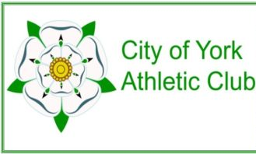

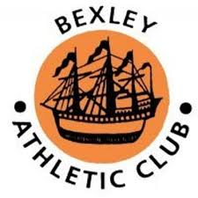





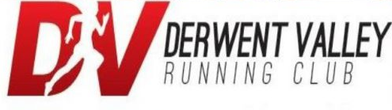















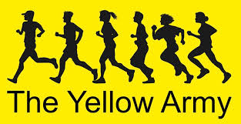




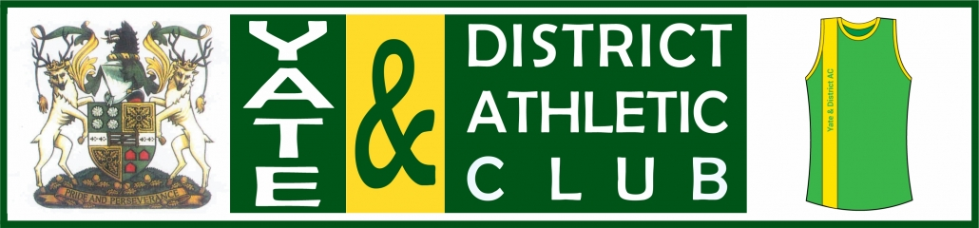






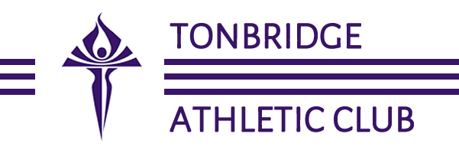
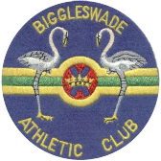

Slide 2
THE BIG ENGLAND
ATHLETICS PUB QUIZ
CLUB

Slide 3
3 Rounds: General Knowledge
Emoji Movie Titles
Athletics Trivia
Answers after all three rounds are complete
Mark your own answers (no cheating)
Let us know your scores

Slide 4
Round 1:
General Knowledge

Slide 5
1.
What is the longest and strongest bone in the Human Body?

Slide 6
2.
How many countries names, end in the letter Y?
Bonus point if you can name them all.

Slide 7
3.
Captain Tom Moore has claimed the hearts of the nation by doing 100 laps of his garden before his 100th Birthday?
Which of the Nightingale hospital openings is he the honorary guest at?

Slide 8
4.
What word links
baby / bean / fish?

Slide 9
5.
True or false. In the average lifetime (79 years) you will produce enough saliva to fill an Olympic sized swimming pool?

Slide 10
6.
How many US states start with the letters NE?
Bonus point if you can name them all.

Slide 11
7.
Named in 2017 by scientist Vazrick Nazari since its yellowish-white head scales were reminiscent of Donald Trump's hair, what species of insect is Neopalpa donaldtrumpi?

Slide 12
8.
What fun name was originally proposed in an online poll to name the research vessel that was eventually called RRS Sir David Attenborough?

Slide 13
9.
If you dug a hole in a straight line through the centre of the earth starting from New Zealand's capital city, which European country would you end up in?

Slide 14
10.
By UK law, ice cream vans are banned from playing their tunes after which time?
A. 7pm
B. 8pm
C. 9pm

Slide 15
Round 2:
Emoji Movie Titles

Slide 16

EXAMPLE.
Blood
Diamond

Slide 17

1.

Slide 18

2.

Slide 19
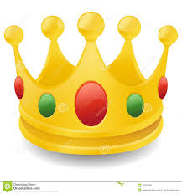
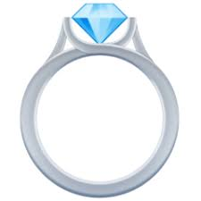
3.

Slide 20

4.

Slide 21

5.

Slide 22

6.

Slide 23
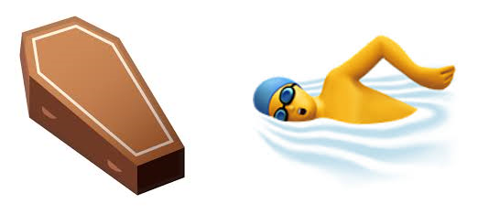
7.

Slide 24
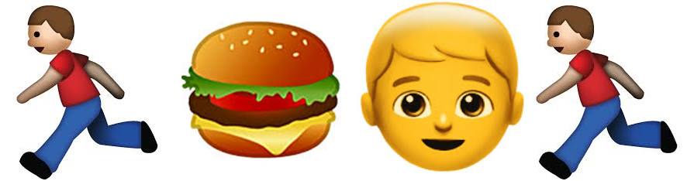
8.

Slide 25
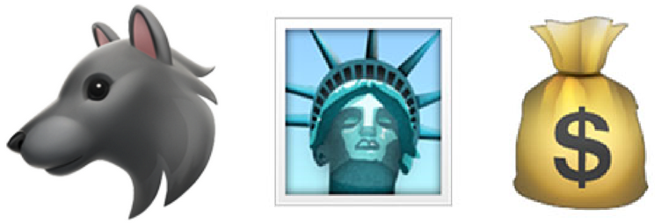
9.

Slide 26

10.

Slide 27
Round 3:
Athletics Trivia

Slide 28
1.
In the current Olympic games events schedule, how many athletics events are there?
(HINT – NO DOUBLE COUNTING)

Slide 29
2.
How many breaths does Usain Bolt take during a 100m sprint?

Slide 30
3.
Firefighter Lloyd Scott is famous for wearing a 130-pound antique deep-sea diving suit during the 2002 London Marathon. He set a record for the slowest marathon time ever for a registered runner, what was the time?
A. 3 days, 1 hour, 13 minutes, 12 seconds.
B. 4 days, 16 hours, 44 minutes, 21 seconds.
C. 5 days, 8 hours, 29 minutes and 46 seconds.

Slide 31
4.
How many Olympic medals has Mo Farah Won?

Slide 32
5.
On this day (21st April) in 1985 Ingrid Kristiansen won the London Marathon in a record 2:21:06. The record wasn’t broken until 2003. The current women’s record of 2:15:25 has stood ever since.
Who holds the record?

Slide 33
6.
O NINJA CLOCKS
Is an anagram for which British Male former Olympic Hurdler?

Slide 34
7.
The world record for the women's high jump (2.09m) has not been broken since the World Championships in 1987.
Where were they held?

Slide 35
8.
During the London 2012 Olympic Games an estimated 14000 meals were consumed by athletes from around the world.
How many loaves of bread were consumed?
18000
25000
32000

Slide 36
9.
In January 2017 the most famous participant in the ‘trackless train half marathon’ in Canada gained international notoriety for coming in 7th place.
Why did they become so famous?

Slide 37
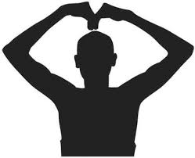
10.
Who is this celebrating? What is the name of their famous celebration?

Slide 38
Answers
Round 1:
General Knowledge

Slide 39
1.
What is the longest and strongest bone in the Human Body?
Femur

Slide 40
2.
How many countries names, end in the letter Y?
Bonus point if you can name them all.
8
Turkey, Norway, Italy, Germany, Hungary, Uraguay, Paraguay, Vatican City

Slide 41
3.
Captain Tom Moore has claimed the hearts of the nation by doing 100 laps of his garden before his 100th Birthday?
Which of the Nightingale hospital openings is he the honorary guest at?
Harrogate, Yorkshire

Slide 42
4.
What word links
baby / bean / fish?
Jelly

Slide 43
5.
True or false. In the average lifetime (79 years) you will produce enough saliva to fill an Olympic sized swimming pool?
True
We are estimated to produce 560000 gallons of saliva during our lifetime

Slide 44
6.
How many US states start with the letters NE?
Bonus point if you can name them all.
6
Nebraska, Nevada, New York (state), New Mexico, New Hampshire, New Jersey

Slide 45
7.
Named in 2017 by scientist Vazrick Nazari since its yellowish-white head scales were reminiscent of Donald Trump's hair, what species of insect is Neopalpa donaldtrumpi?
A Moth

Slide 46
8.
What fun name was originally proposed in an online poll to name the research vessel that was eventually called RRS Sir David Attenborough?
Boaty McBoatface

Slide 47
9.
If you dug a hole in a straight line through the centre of the earth starting from New Zealand's capital city, which European country would you end up in?
Spain

Slide 48
10.
By UK law, ice cream vans are banned from playing their tunes after which time?
A. 7pm
B. 8pm
C. 9pm

Slide 49
Answers
Round 2:
Emoji Movie Titles

Slide 50
1.
Watership Down

Slide 51
2.
Polar Express

Slide 52
3.
Lord of the Rings

Slide 53
4.
Chicken Run

Slide 54
5.
Star Wars

Slide 55
6.
No time to die

Slide 56
7.
Dead Pool

Slide 57
8.
Run Fat Boy Run

Slide 58
9.
The Wolf of Wall Street

Slide 59
10.
The Kings Speech

Slide 60
Answers
Round 3:
Athletics Trivia

Slide 61
1.
In the current Olympic games events schedule, how many athletics events are there?
26
Notes:
10000M 100M 100M HURDLES 110M HURDLES 1500M 200M 20KM RACE WALK 3000M STEEPLECHASE 400M 400M HURDLES 4X100M RELAY 4X400M RELAY 5000M 50KM RACE WALK 800M DECATHLON DISCUS THROW HAMMER THROW HEPTATHLON HIGH JUMP JAVELIN THROW LONG JUMP MARATHON POLE VAULT SHOT PUT TRIPLE JUMP

Slide 62
2.
How many breaths does Usain Bolt take during a 100m sprint?
0
Notes:
Anaerobic – no oxygen

Slide 63
3.
Firefighter Lloyd Scott is famous for wearing a 130-pound antique deep-sea diving suit during the 2002 London Marathon. He set a record for the slowest marathon time ever for a registered runner, what was the time?
A. 3 days, 1 hour, 13 minutes, 12 seconds.
B. 4 days, 16 hours, 44 minutes, 21 seconds.
C. 5 days, 8 hours, 29 minutes and 46 seconds.

Slide 64
4.
How many Olympic medals has Mo Farah Won?
4
Notes:
5000m, 10000 at London & Rio

Slide 65
5.
On this day (21st April) in 1985 Ingrid Kristiansen won the London Marathon in a record 2:21:06. The record wasn’t broken until 2003. The current women’s record of 2:15:25 has stood ever since.
Who holds the record?
Paula Radcliffe

Slide 66
6.
O NINJA CLOCKS
Is an anagram for which British Male former Olympic Hurdler?
Colin Jackson

Slide 67
7.
The world record for the women's high jump (2.09m) has not been broken since the Olympic games in 1987. Where were these games held?
Rome

Slide 68
8.
During the London 2012 Olympic Games an estimated 14000 meals were consumed by Athletes from around the world.
How many Loaves of bread were consumed?
18000
25000
32000

Slide 69
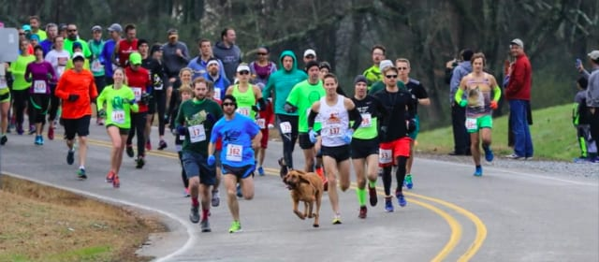
9.
In January 2017 the most famous participant in the trackless train half marathon in Canada gained international notoriety for coming in 7th place. Why did they become so famous?
He was a 2 year old bloodhound called Ludivine

Slide 70
10.
Who is this Celebrating? What is the name of their famous celebration?
Mo Farah
The Mobot

Slide 71
The End
Let us know your scores

